Slide 1
Orem Ward Family History Program
Presented by Lloya Hall
Summarized by Dion Davidson

Slide 2
Outline
Committee organization
Ideas for a successful family history program
Self-help guide
  5 generation checklist
Priesthood leadership

Slide 3
Results-oriented Committee
Lloya resolved to be results oriented
Her bishop called 5 people to a committee, which grew to 15 people
In 3.5 years, her ward did ordinance work for 4000 names, representing 30-40 families in the ward.

Slide 4
Organization of a Committee
A ward Family History committee needs enough members to smoothly carry forth the many tasks related to a successful program in a ward unit. Following are possible positions on a Family History committee.
Head Family History Consultant
  Organizes and runs the committee. Holds bi-monthly or quarterly committee meetings. Heads up all FH activities in the ward. Interfaces with the stake FH consultant. Can attend ward council meetings when invited.
Publicity
  Puts announcements in bulletins, produces Family History fliers and newsletters as needed. Makes reminder posters etc.
Computer Specialists
  Installs PAF on ward members computers and gives them basic instruction on how to use it. Two or three individuals are needed who can do this.
Youth Specialists
  Assists the YM/YW presidencies to carry forth programs for the youth such as baptisms for names researched in the ward, ancestor research, merit badge and personal progress classes, and special class activities at the FHC. Can also serve the Primary as needed.

Slide 5
Organization of a Committee (cont)
Research Specialists
  Meets with ward members at the FHC and helps them with their research problems. There should be several committee members who can do this.
Trainer
  Trains new committee members on how to run computer programs, do basic research and consult with ward members.
Lists and Files Specialist
  Supervises the sign up sheets that go through Sunday School, Relief Society and Priesthood classes each Sunday. Sign up sheets should go around for weekly scheduled times at the Family History Center, for those wishing to participate in preparing names for ward temple days etc. This committee member also keeps a card file containing temple-ready family names of ward members who need help with ordinance work and oversees the distribution and return of these cards.

Slide 6
Organization of a Committee (cont)
Sunday Instructor
  Teaches the Sunday Family History class. In addition to the standard beginning Family History Class, it is helpful to run a series of mini-classes lasting 3 or 4 weeks specializing in one topic such as the PAF Program, Familysearch.org., Internet Research, Filing Systems, Research Techniques etc. It is possible to use laptops and TV screens to effectively teach these subjects.
Temple Specialists
  Arranges for ward temple events such as baptisms, endowment nights, sealing sessions etc. Helps members get files Temple Ready.
Phone Specialists
  Someone who may be homebound can make appointments and reminder calls.
High Priest Group Leader
  Sits on the Family History committee and attends meetings. Is a liaison with the bishopric and ward council.

Slide 7
Hands-on for success
To be successful, a ward Family History Program must be hands on. It cannot be just a Sunday class. Ward members need side-by-side instruction in all phases of Family History work to not feel overwhelmed by this effort. If a ward member attends the Sunday class, has in-home personal computer help and attends the Family History Center with a committee member who guides them through the research process, family history will become one of the most exciting activities a ward can be involved in. The spirituality in a ward will increase as ward members attend to temple ordinances for their own family members.

Slide 8
A Successful Ward Family History Program
Set a goal
  Set a date and schedule a ward temple day. Plan to prepare and take family names to the temple that day. Perhaps you can set a goal to baptize the equivalent of your ward in the spirit world during the coming year. You just might end up baptizing a stake!
Advertise!
  Use announcements, sign-up sheets, newsletters, hand-outs, and role-playing (visiting ancestors in period dress) to publicize your goals. Hold a sacrament meeting on family history.
Sunday Classes
  Use modern technology to turn an old, tired family history class into the latest and greatest Sunday School class held. Laptops, big screens and Internet access to familysearch.org goes a long ways in getting people interested in doing family history.
Involve the Youth
  Set a day for ward baptisms and help the youth and their parents research and prepare names. Then, youth and their parents attend the temple together for ward family baptisms. Priesthood holders can baptize and confirm while youth are proxies.

Slide 9
Ward Program (cont)
Family History Center Appointments
  Pass around a sign-up sheet every Sunday to attend the FHC. Schedule certain times when ward committee members will be available to go with ward members to the center and help them research.
Family History Self-Help Guide
  Publish a booklet or CD for your ward members that contains how-to checklists and step-by-step instructions for basic computer, Internet and research skills. Also, include ward temple dates, FHC hours, committee members names and numbers. Be sure to include your ward goals and goal setting sheets for families to fill out.
PAF Installation Program
  Computer specialists see that ward members have PAF installed on their computers and receive personal, in-home instruction on its use.
Ward Card File
  Maintain a file of temple cards of ward member.s family names. This is mainly for those who have many names and few family members who can perform the ordinances. Pass temple cards around every Sunday for members to take to the temple during the week.

Slide 10
Ward Program (cont)
Ward Temple Days
  Schedule days to do family names at the temple. You can have Baptism days, Endowment Days, and Sealing Days. Those who do not have names can help do ordinance work for those who have found multiple names. This is a wonderful way to become close as a ward and lift the members spiritually.
Family History Ward Activity
  Work with the ward Activity Committee to hold a Ward Family History Super Saturday. Along with classes and displays, schedule families to 80 come at appointed times for individual goal setting and hands-on training on computers and Internet. Each family brings their own five-generation pedigree chart to use as they practice on the computers. Families can research their ancestor's pioneer stories and journal entries on Infobase's Pioneer Heritage Library. Set up equipment to scan photos into PAF. Organize a file system. Find out who is related to whom!
Family History Enrichment Night
  Family History mini-classes on organizing FH files, using the computer, scrap-booking, Family Heritage books.
Family History Library Research Days
  Schedule a day at the Family History Library in Salt Lake or at BYU where ward members with research problems meet committee members at appointed time for individual help.

Slide 11
Self-help Guide
Getting Started
  Flowchart
Personal Ancestral File
Download family files
Getting Organized
Five Generation Checklist
Research Skills
Internet Family History
Submitting Names for Temple Work

Slide 12
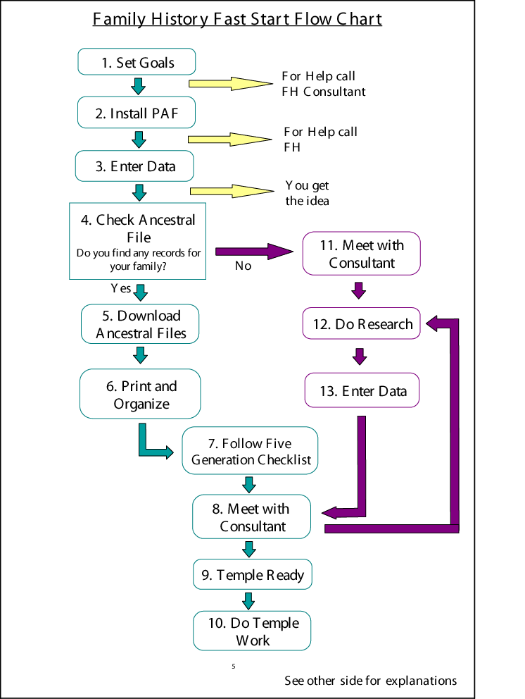

Slide 13
5 Generation Checklist
Check your direct line (back to great-great grandparents)
Check families of direct line
Descendancy check (grandchildren of 5th generation)

Slide 14
Priesthood Leadership
Successful Family History Work Begins With Priesthood Leadership and Support.
Bishop
  A bishop can make all the difference in the success of family history work in his ward. If the bishop is committed to family history, his testimony will shine forth to other ward members. A bishop can assist this work by:
    Making sure his ward has a dedicated Head Family History Consultant called.
    Calling 5-10 or more individuals to the Family History Committee.
    Scheduling a sacrament meeting on Family History.
    Giving verbal attention to Family History activities over the pulpit.
    Participating in Family History activities as his time allows. A little bit goes a long way.
    Working with the High Priest Group leader to encourage Family History.
    Providing some budget resources for the Family History Committee for printing costs, publicity, temple night refreshments etc.
    Encouraging an annual hands-on Family History fair on a ward basis.
High Priest Group Leader
  The High Priest Group Leader has the stewardship over the family history work in his ward. He can be a great asset to the Family History Committee by:
    Attending Family History classes and activities.
    Helping to instigate temple events and ordinance work.
    Attending Family History committee meetings.
    Being involved in his own Family History work.
    Giving verbal attention to Family History activities in priesthood meetings.
    Encouraging all high priests to be involved in temple and family history work.

Slide 15
Contact Info
Lloya Hall
  lloyahall@yahoo.com
Dion Davidson
  diondavidson@yahoo.com

